Slide 1

DA LAPAROTOMIA A LAPAROSCOPIA FINO ALLA PIATTAFORMA ROBOTICA: STEP BY STEP OPPURE SALTO AD OSTACOLI
Massimiliano Di PaolA
Ospedale san pietro fatebenefratteli
Roma

Slide 2



Slide 3
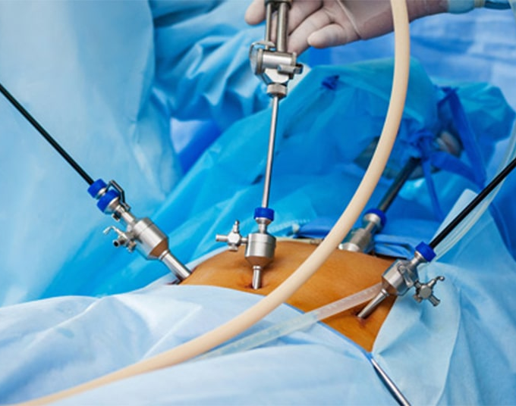


Premessa…..
Prof. Cristiano Germano Huscher

Slide 4
Laparotomia > Laparoscopia
Step by step oppure salto ad ostacoli

Slide 5

LAPAROSCOPIA
Smaller Incisions:
Laparoscopic surgery uses small incisions (about 0.5 to 1.5 cm) compared to the larger incisions of open surgery.
Less Trauma:
The smaller incisions and reduced tissue disruption mean less trauma to surrounding tissues, resulting in less pain and swelling.
Minimal Scarring:
The smaller incisions lead to minimal scarring, which is often barely noticeable.
Shorter Hospital Stay:
Patients typically spend less time in the hospital, as the reduced trauma allows for faster healing and return to normal activities.
Quicker Return to Daily Life:
The faster recovery allows patients to resume their daily activities and work sooner.
Less Postoperative Pain:
The smaller incisions and less tissue disruption mean less nerve damage and pain.
Reduced Need for Pain Medication:
Patients generally require less pain medication after laparoscopic surgery. :
Less Blood Loss:
Laparoscopic surgery generally results in less blood loss during and after the procedure.
Lower Risk of Infection:
The smaller incisions reduce the risk of infection compared to open surgery.
Reduced Risk of Other Complications:
Laparoscopic surgery also lowers the risk of other postoperative complications, such as wound separation and incisional hernia.
Improved Cosmetic outcome: The small incisions leave minimal scars, which are often barely noticeable.

Slide 6

Perchè ?

Slide 7
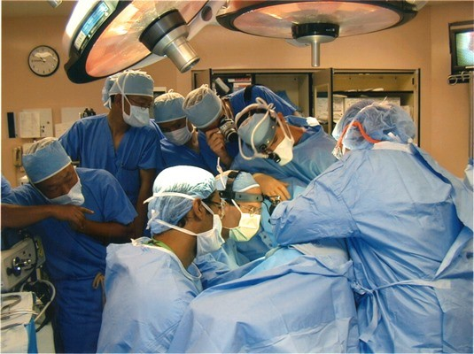


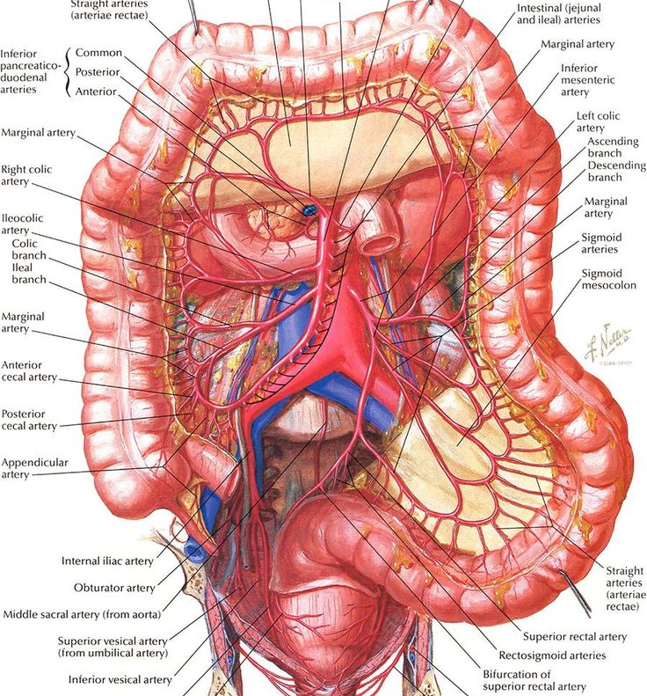
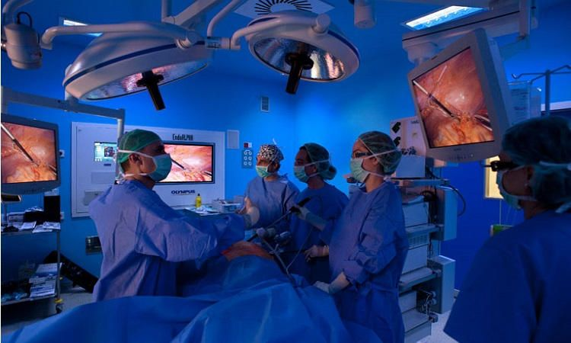


Slide 8


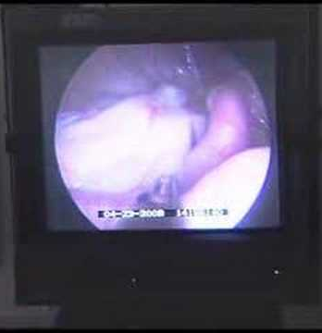
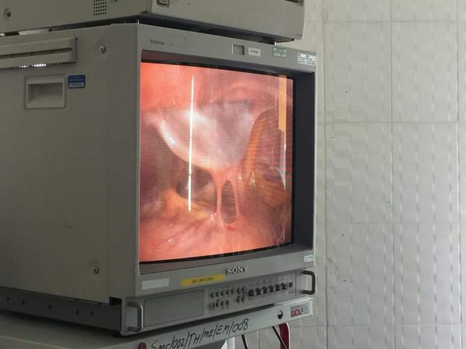
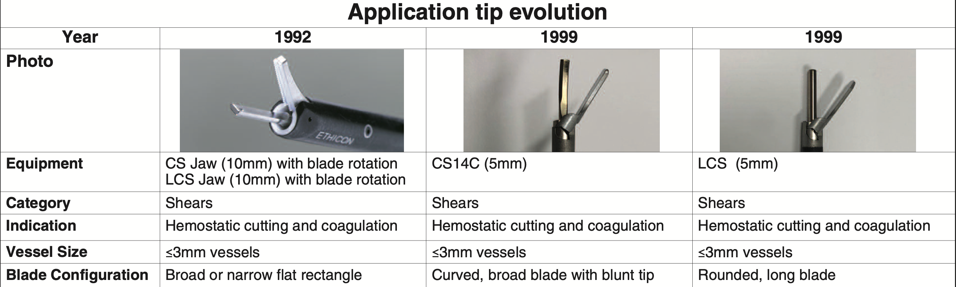

Slide 9
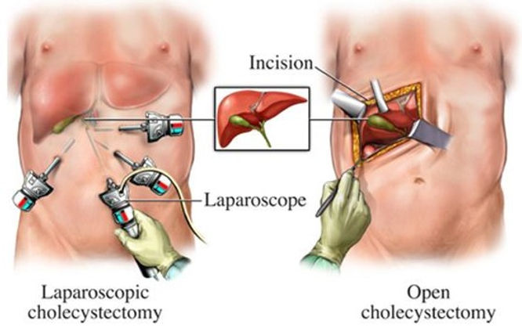

Nonostante i vantaggi …..la laparoscopia fu all’inizio bistrattata
Prof Basso

Slide 10
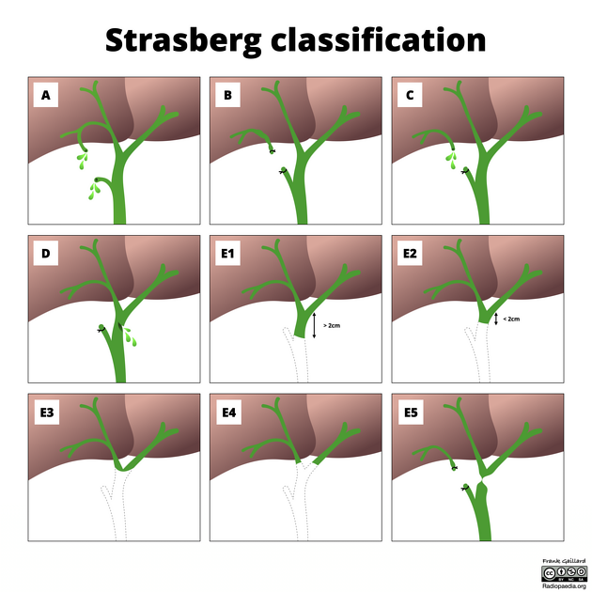
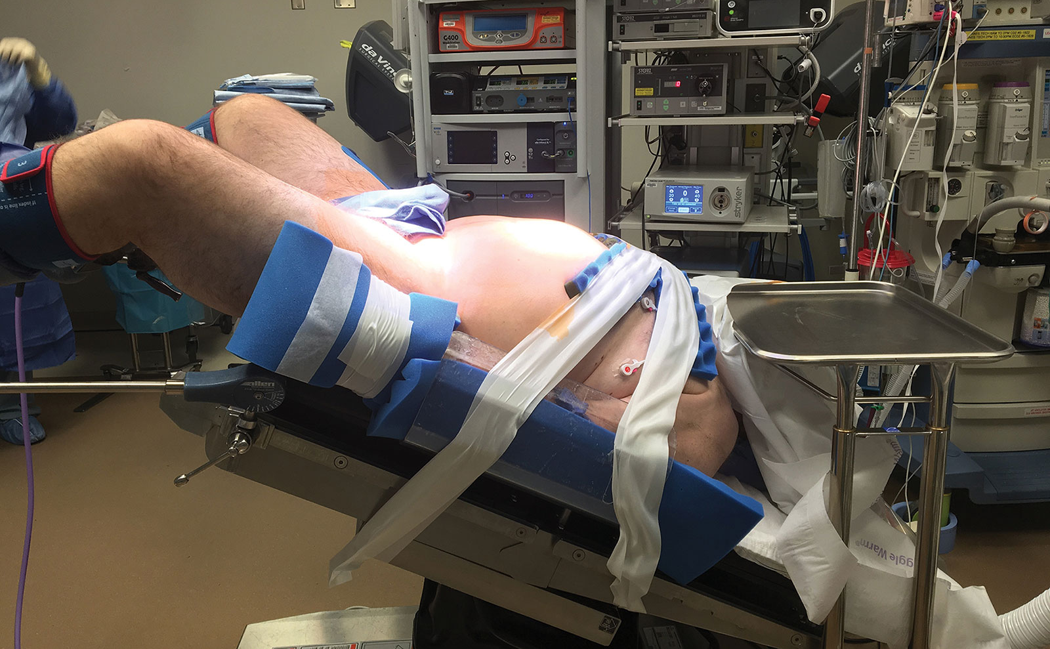
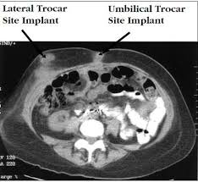
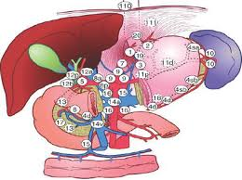

Slide 11


Laparotomia > Laparoscopia

Slide 12

Laparoscopia > Robot

Slide 13
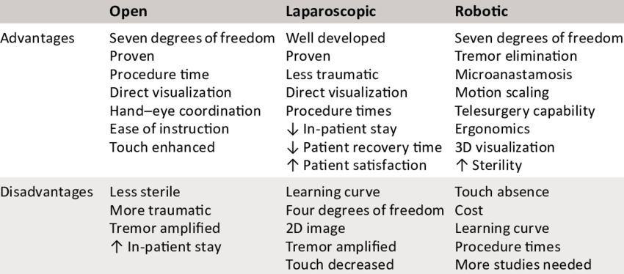
Paziente e Chirurgo

Slide 14
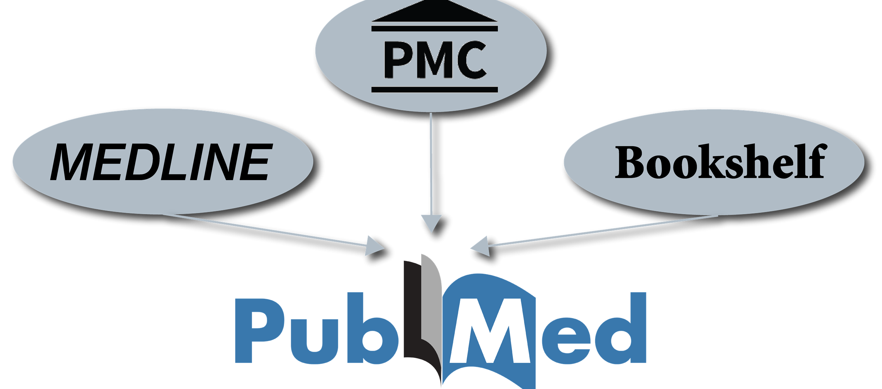
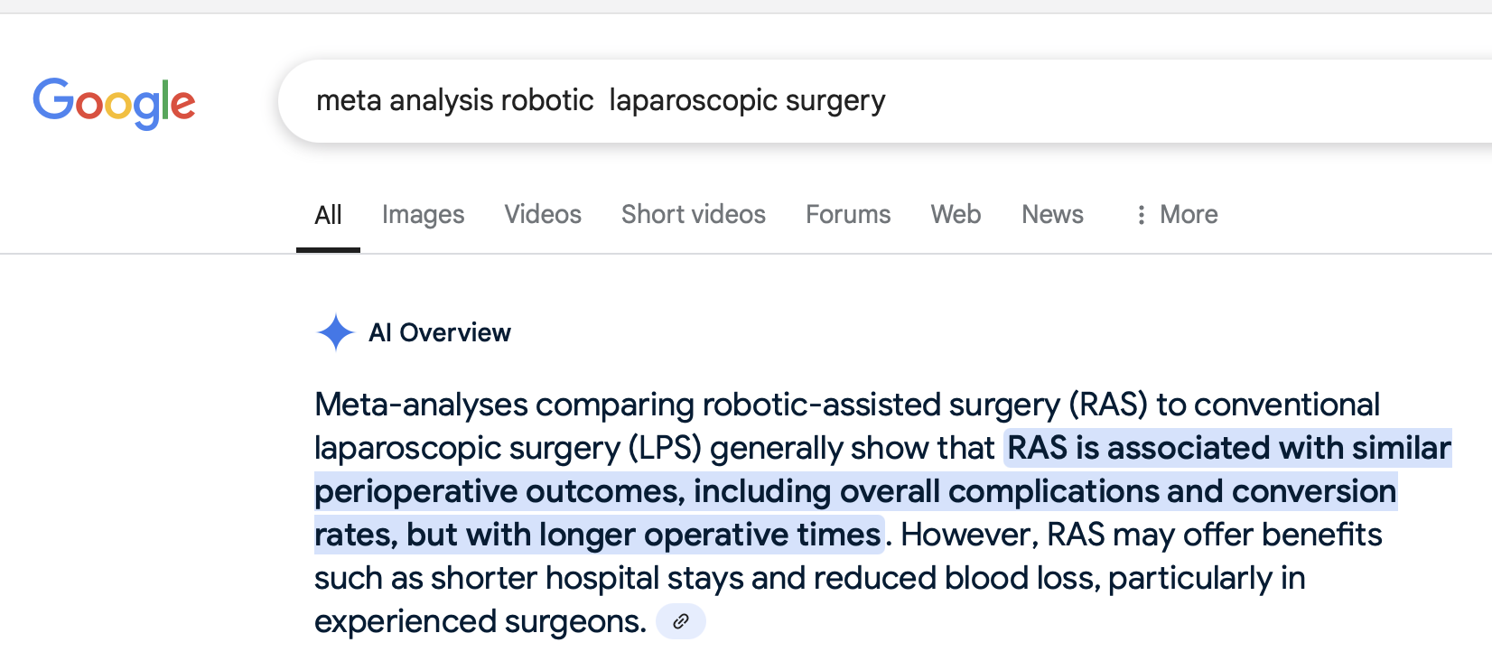

Slide 15
Meta-analyses comparing robotic-assisted surgery (RAS) to conventional laparoscopic surgery (LPS) generally show that RAS offers similar perioperative outcomes to LPS, but with longer operating times:
Similarities:
Perioperative outcomes:
Many meta-analyses find no significant difference in overall complications, surgical site infections, reoperation rates, or anastomotic leaks between RAS and LPS.
Conversion rates:
Some studies show no difference in the rate of conversion to open surgery between RAS and LPS.
Blood loss:
While some studies show less blood loss with RAS, others find no significant difference.
Hospital stay:
Some studies report shorter hospital stays with RAS, while others show no significant difference.
Differences:
Operating time:
RAS consistently requires a longer operating time compared to LPS.
Conversion rates:
Some meta-analyses suggest a lower conversion rate with RAS, particularly in rectal cancer surgery.
Blood loss:
Some meta-analyses indicate less blood loss with RAS, especially in colorectal surgery.
Hospital stay:
Some meta-analyses show a trend towards shorter hospital stays with RAS, particularly in colorectal surgery.
Conclusion:
While RAS offers some potential advantages over LPS in specific areas, such as potentially lower conversion rates and shorter hospital stays in some cases, it's important to remember that the overall perioperative outcomes are largely comparable. The choice between RAS and LPS should be made on a case-by-case basis, considering factors such as the specific procedure, patient characteristics, surgeon experience, and available resource

Slide 16
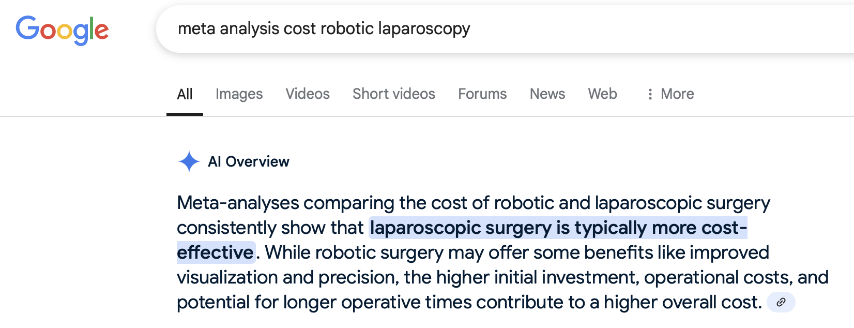

Slide 17
Meta-analyses comparing the cost of robotic and laparoscopic surgery consistently show that laparoscopic surgery is typically more cost-effective. While robotic surgery may offer some benefits like improved visualization and precision, the higher initial investment, operational costs, and potential for longer operative times contribute to a higher overall cost.
Elaboration:
Laparoscopic surgery is generally cheaper:
Studies have consistently found that laparoscopic surgery results in lower total costs, including operative costs and hospital stays, compared to robotic surgery.
Robotic surgery has higher initial costs:
The high initial investment in robotic systems, as well as the ongoing costs of maintenance and training, contribute significantly to the higher overall cost of robotic surgery.
Potential benefits of robotic surgery:
While robotic surgery may offer some benefits like improved visualization and precision, these benefits do not always translate into lower overall costs.
Trade-offs in cost and effectiveness:
Some studies have found that while robotic surgery may offer some benefits in specific areas, such as reduced complications, the higher costs may outweigh these benefits in a cost-effectiveness analysis.
Important considerations:
When considering robotic surgery, it's important to weigh the potential benefits against the higher costs and consider the specific clinical context and patient population.

Slide 18


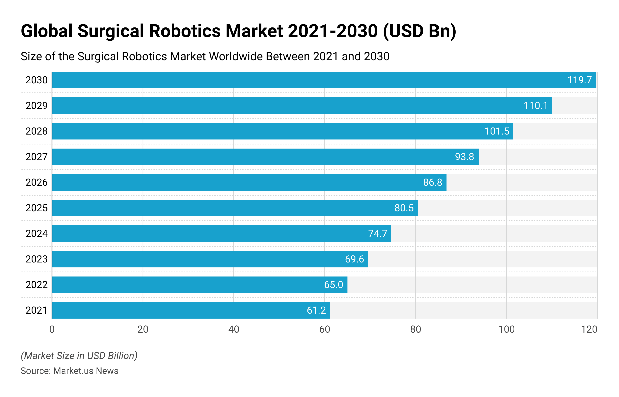

Slide 19



15.256 borse messe a bando per il 2024, solo
il 75% è stato assegnato.
Quelle assegnate per la Chirurgia Generale sono state soltanto il 51% di quelle disponibili

Slide 20
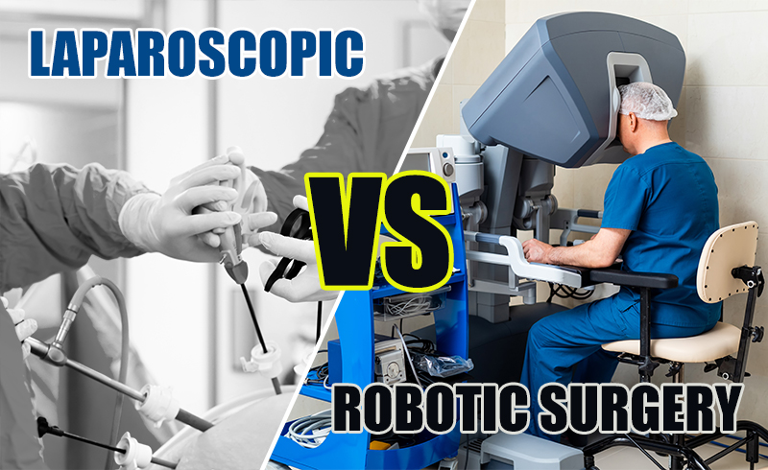

Slide 21
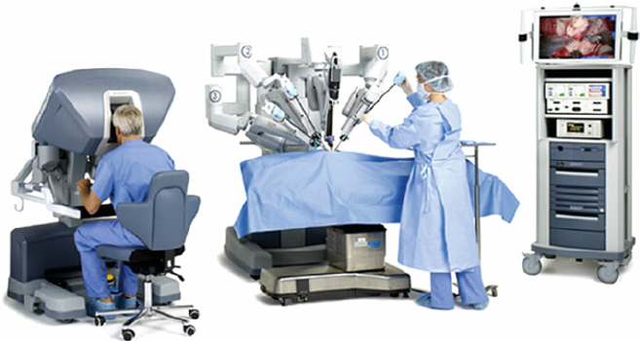

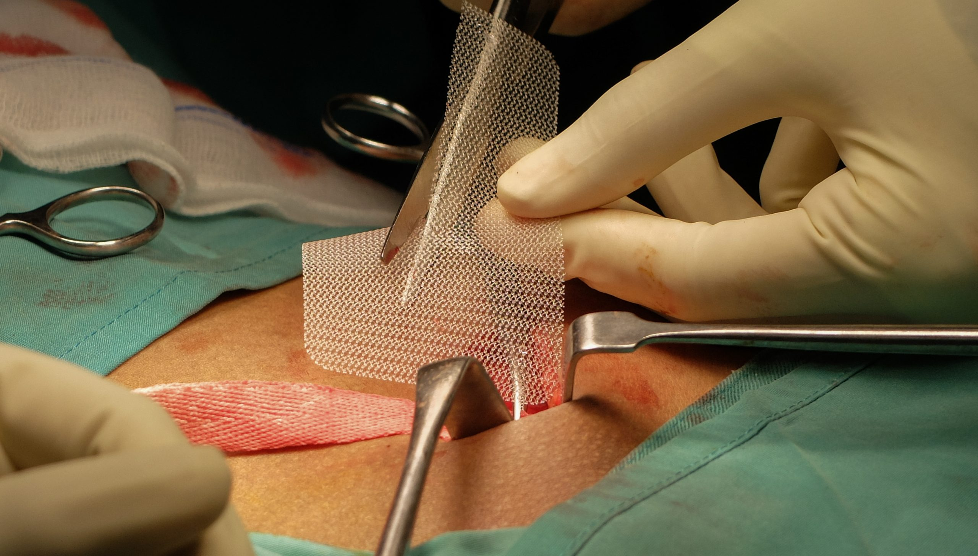

Slide 22





Slide 23

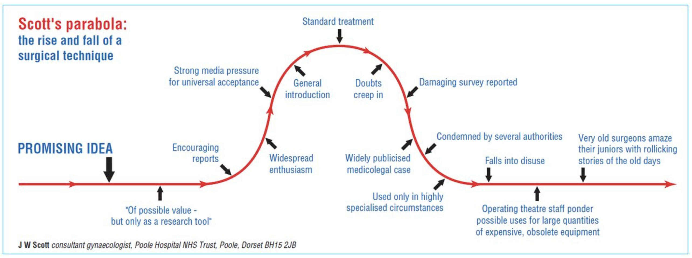


Slide 24
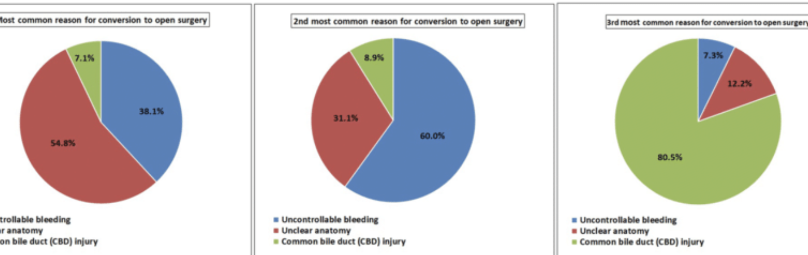


1. Malfunzionamenti Tecnici
Guasti ai sistemi robotici, come cortocircuiti o errori nei sensori, possono compromettere l'operazione.
Dal 2000 al 2013, la FDA ha registrato oltre 10.000 segnalazioni di eventi avversi legati alla chirurgia robotica, con oltre 1.500 incidenti significativi, tra cui ustioni e danni agli organi.
Un'analisi delle segnalazioni della Pennsylvania Patient Safety Authority ha evidenziato che il 43,5% degli eventi avversi gravi erano dovuti a lacerazioni accidentali, mentre il 17,5% a emorragie.
La variabilità nella formazione dei chirurghi e la mancanza di protocolli uniformi possono influire sulla sicurezza e sull'efficacia degli intervent

Slide 25
E poi…….

Slide 26


Complottismo…..

Slide 27


Slide 28






Slide 29



Slide 30

Grazie

